Slide 1
AD 571- PRESENTATION
By – Aravind Hanumantha rao

Slide 2
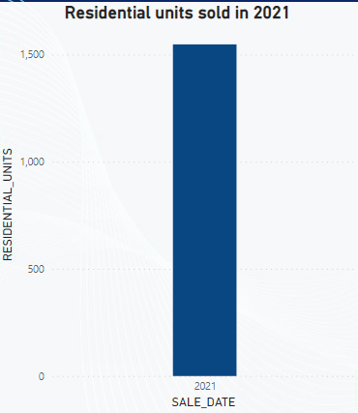
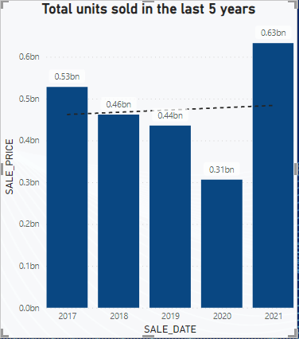
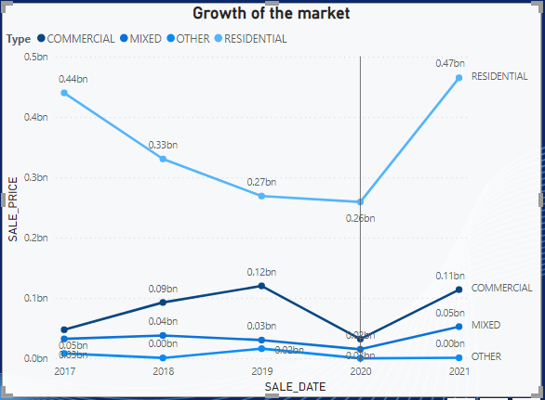
NEIGHBOURHOOD – SUNSET PARK
Sunset park is located in Brooklyn New York
Residential units sold in 2021 -1500 units
3) Growth of the residential market
4) Total units sold in the last 5 years

Slide 3
Understanding sunset park
Descriptive – Understand the historical data of sunset park and look into the past trends and patterns of the neighbourhood
2) Predictive – Using a model to analyse the forecast for sunset park . Forecasting tools to predict the sales of the model ,seasonality . Tools that were used are time series, Regression forecast and regression prediction
3) Prescriptive - Develop a optimization model to maximize profits and minimize costs associated to my neighbourhood .( Based o n opening a new office )

Slide 4
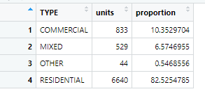
Descriptive ANALYSIS – PROPORTION OF UNITS SOLD
The residential units proportion are higher compared to other building types .
Seen from the data -Residential units in sunset park is 82 percent

Slide 5
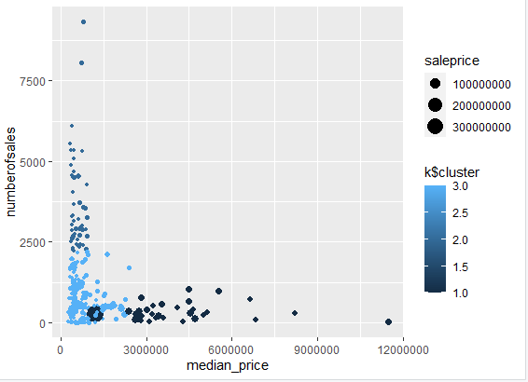
Descriptive analytics -K – MEANS CLUSTERING
The three KPI’S That I have used is Sale price –
1)Median sale price
2)Number of sales
3)Standard deviation of sales
My neighbourhood is sunset park and as seen from my data , the cluster is - 2
Conclusion
The cluster of my neighbourhood includes - higher sales and lower median price .
Closer to the mean than further apart

Slide 6
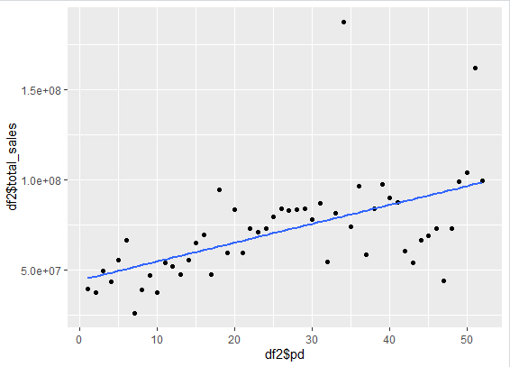
Predictive analytics – SEASONALITY
it doesn’t show any seasonality. Each quarter the value changes accordingly and isn’t the same and there is also a trend line in the data of my neighbourhood sunset park. As seen from the data, my model is additive and my seasonal trend for each quarter won’t be the same and will vary over time. As the time for the years keep increasing, the total sales also increase.

Slide 7
WHY IS MY Data additive ?
Choose the additive model when the magnitude of the seasonal pattern in the data does not depend on the magnitude of the data. In other words, the magnitude of the seasonal pattern does not change as the series goes up or down.

Slide 8
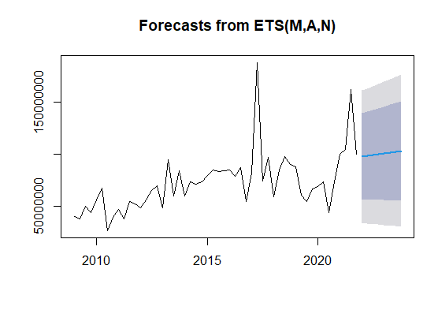
PREDICTIVE ANALYTICS –TREND LINE
Seen from my forecast , there is multiplicative errors and there is a additive trend in my forecast .
My forecast doesn’t have any seasonality and there is a slight increase in sales price for the next 8 quarters.

Slide 9
Prescriptive ANALYTICS– OPTIMIZATION MODEL
The prediction of the sales forecast for the next 8 quarters for sunset park is projected using the model .
Sales projection gives the determinant on whether the new office setup would be profitable or not with the given variables .
Based on the sales projection , sunset park needs 2 employees for the given budget and 4.76 percent
We are already profitable and making a lot of cash and profits , if everything goes by the projection .(NPV profit -1873469.07)
That’s the reason why haven’t kept a lot on advertising and budgeting cost.

Slide 10
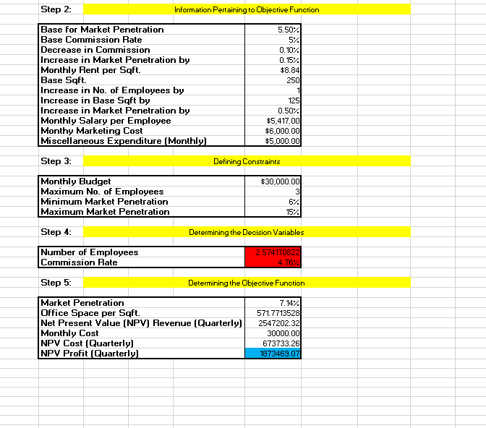

Slide 11
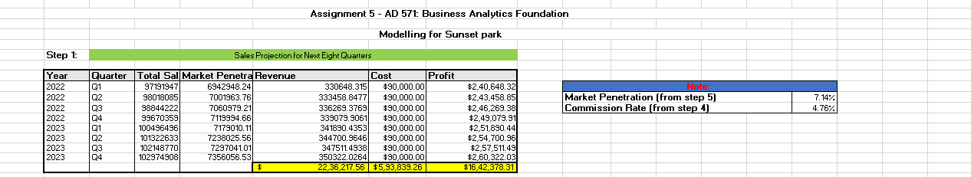

Slide 12
VALUE FOR OUR ANALYSIS
Descriptive analysis – How past data helps in understanding the model and gives a detailed description on how the neighbourhood is working . From sales , growth of the market and how the trend lines have been looking for the previous years
Predictive analysis – How data enables in predicting future sales , helps in building corelation and relationship between different variables . Moreover , how data helps in building meaningful projections
Prescriptive model – how the meaningful projection helps in building optimization models with the given variables . Optimization model gives a near to perfect result on the output of the variables

Slide 13
WEAKNESS OF THE ANALYSIS
Built on historical data ( doesn’t take into account of uncertainties)
Time series analysis includes problems with generalization from a single study, difficulty in obtaining appropriate measures, and problems with accurately identifying the correct model to represent the data.
Optimization model may be inaccurate if there isn’t many variables to determine the output

Slide 14
Recommendations for the company
1)What other variables the company can take into account to know the market penetration rate and commission rate . The market for real estate is really volatile and the figures estimated in the model may not be exactly the same. Other analytics can be used in the model
2) My company is estimated to make huge profits , therefore they may think to open more than one office in future because they aren’t inheriting huge costs and have 1873469 in profits . The costs estimated for budget is low but even if I keep a budget of 40-50 thousand dollars , I will still return a profit . So there is leverage for the company to increase their market penetration rate due to the returns .

Slide 15


